Slide 1
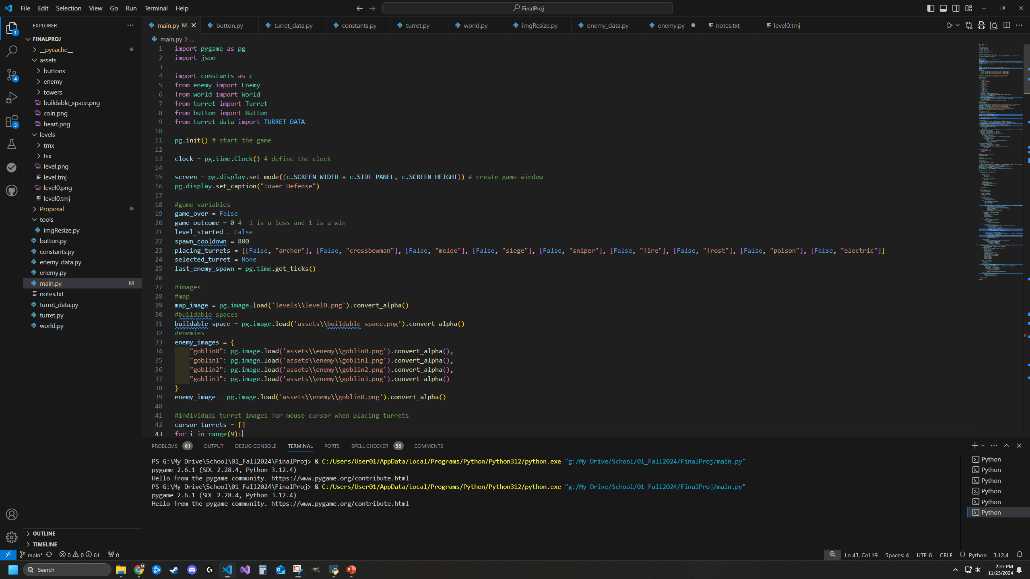
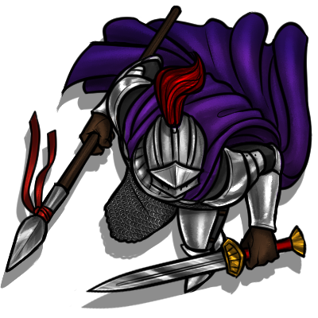
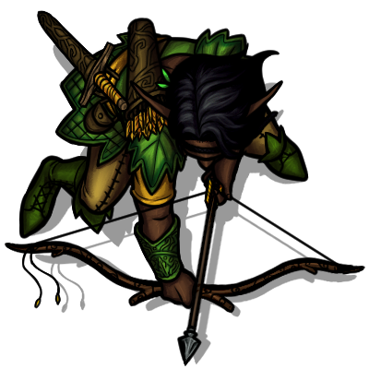



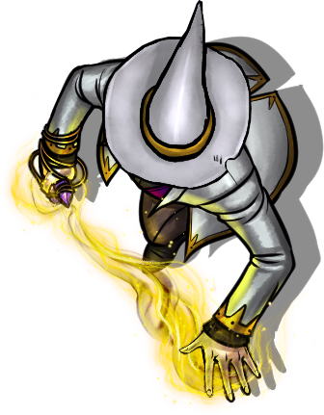
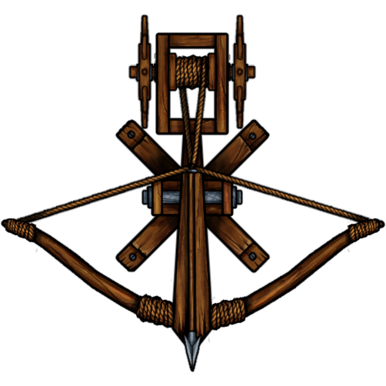
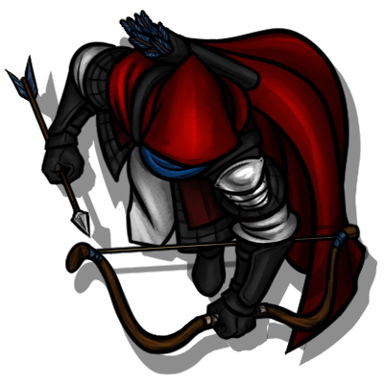
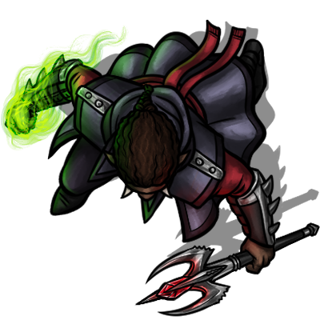
CS 210: Final Project Proposal
Mason Leavitt
Fall 2024
PORTAL GUARDIAN
Implemented with Pygame

Slide 2
OVERVIEW
Portal Guardian
A wave-based tower defense game
https://github.com/Student5691/Tower_Defense_Portal_Guardian
Basic Mechanics
28 Levels with difficulty scaling, random enemy order per play iteration
8 enemy categories, 29 types total, each with custom stats
9 deployable towers/unit categories, 4 upgrades each, 45 unique units overall
Features
Music, SFX, volume controls, basic animation, undo (ctrl+z), hiscores (top 10), player choice on path progression, hand-crafted battle map, fast-forward

Slide 3
Data Structures/Algorithms and Usage
Lists: Lists of classes and other metadata
Hash Table: Enemy/tower/SFX metadata
Deque/Stack/Queue: Undo system (Ctrl+z)
Tree: Choose which type of enemy to fight next based on a randomly generated tree at runtime
Graph: Allow for random pathing for a special enemy type via an adjacency list
Searching: Linear searches (find buildable tiles)
Sorting: High scores (stretch goal)
GUI: Pygame (engine), GIMP (image editor), TILED (base map), Audacity (SFX)

Slide 4
UML
World
Turret
+level: int
+game_speed: int
+waypoints: list
+lives: int
+money: int
+tile_map: list
+level_data: dict/JSON
+map: .png
+enemies_created: int
+enemies_killed: int
+enemies_missed: int
+enemy_list: list
+type_data: dict
+upgrade_level: int
+upgrade_limit: int
+original_img: PG Surface
+image: PG Surface
+angle: int
+range: int
+cooldown: int
+update_time: int
+last_shot: int
+rect: Pygame (PG) Rect
+tile_x: double
+tile_y: double
+x: double
+y: double
+selected: bool
+range_ring: PG Surface
+range_rect: PG Rect
+target: Enemy
+process_data()
+process_enemies()
+check_level_complete()
+reset_level()
+draw_map(
Enemy
+update()
+draw()
+targeting()
+upgrade()
+type: string
+position: PG Vector2
+base_hp: int
+hp: int
+speed: list
+angle: int
+original_img: PG Surface
+image: PG Surface
+rect: PG Rect
+waypoints: list
+target_waypoint: int
+target: PG Vector2
+movement: PG Vector2
Button
+image: .png
+rect: Pygame (PG) Rect
+clicked: bool
+single_click: bool
+draw_button()
+update()
+move()
+rotate()
+draw_hp()
+check_alive()

Slide 5
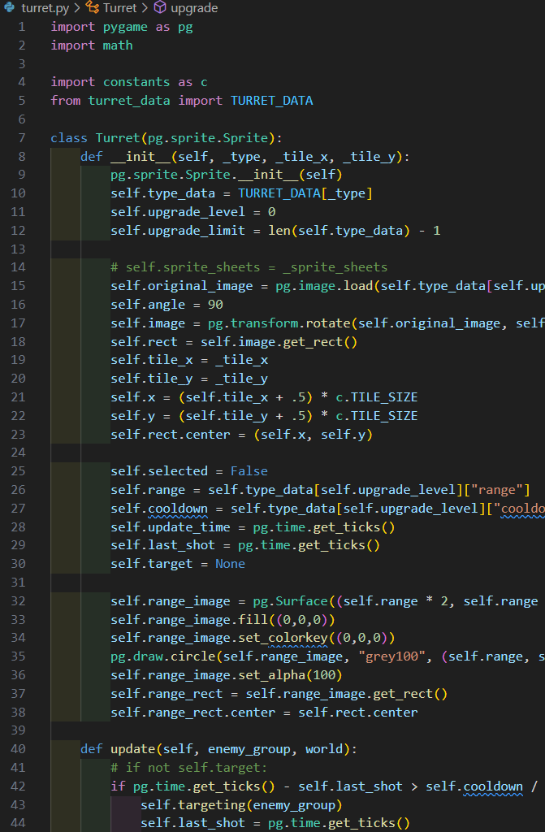
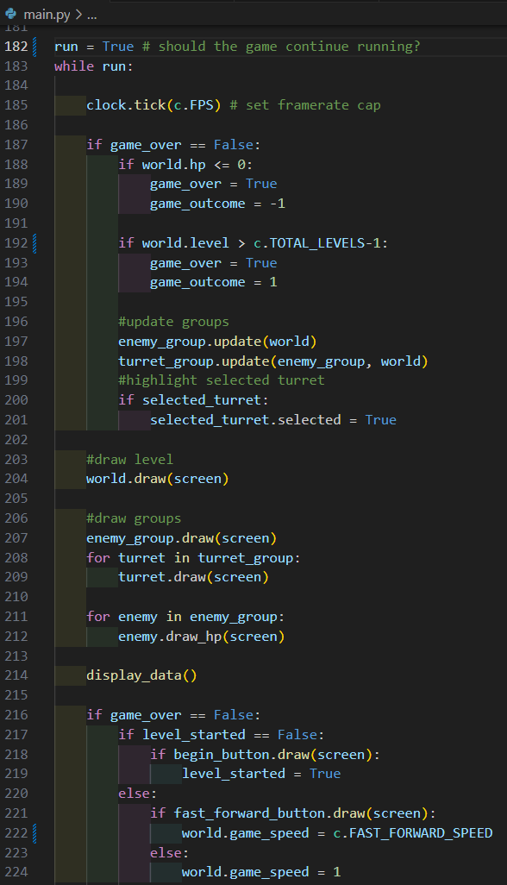
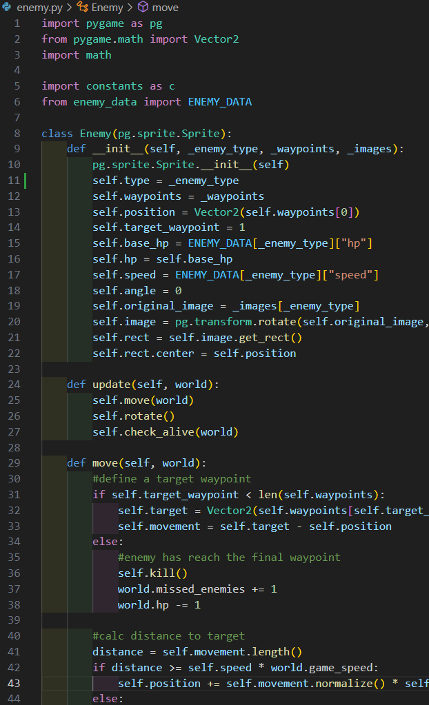
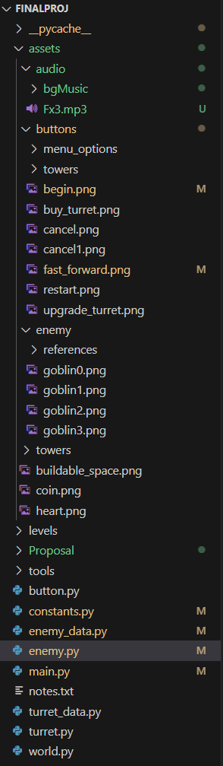
Code Samples

Slide 6
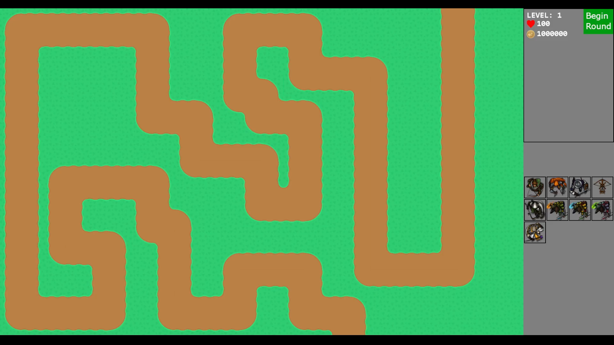
UI via Pygame
Game Window
Side Panel
Game Screen
Game Screen
Base map image
Enemy movement path
Buildable tile indicators
Appears when placing towers
Built towers
Enemies
Toggleable tower ranges
Side Panel
Game data (current level, lives, money)
Begin round button
Fast-forward button
Buy-Tower grid
Tower info display (in development)
Sell tower (in development)
*More additions likely as development continues
Continue to see current UI implementation

